Slide 1
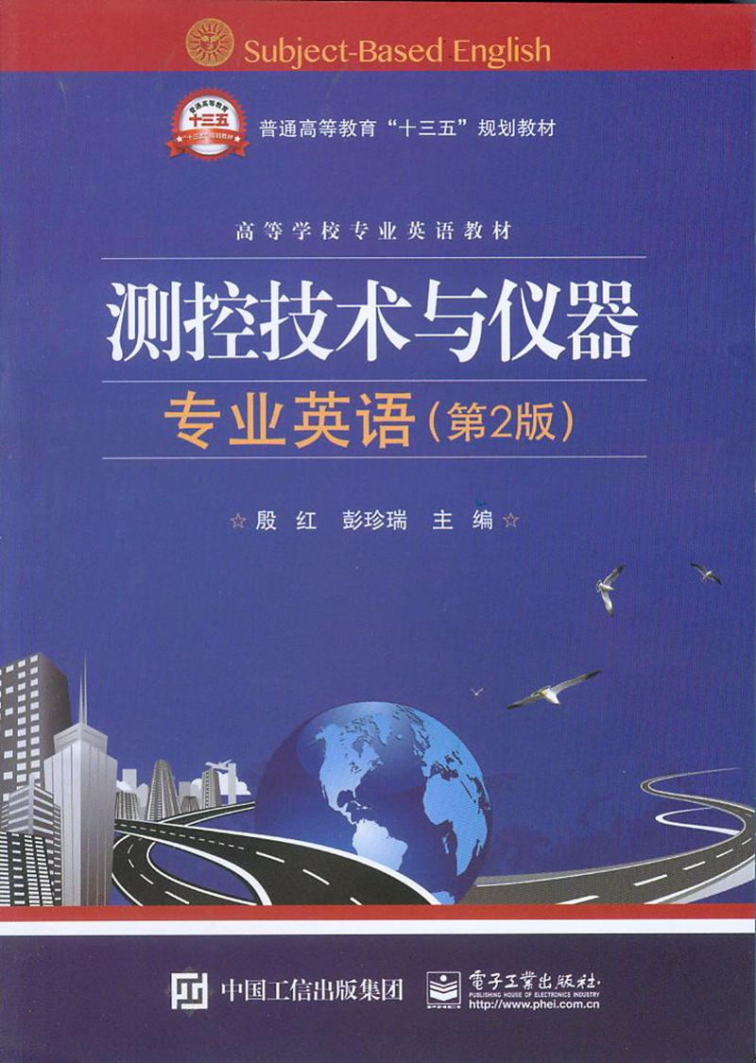
Unit9 Microcontroller

Slide 2
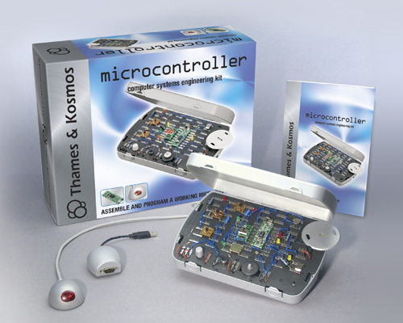
Unit9 Microcontroller

Slide 3
A microcontroller (sometimes abbreviated（缩写，简化）µC, uC or MCU) is a small computer on a single integrated circuit containing a processor core, memory, and programmable input/output peripherals（（计算机的）外围设备，周边设备）. Program memory in the form of NOR flash is also often included on chip, as well as a typically small amount of RAM.
句中NOR flash是一种非易失闪存技术。NOR主要应用在代码存储介质中，NOR Flash存储少量的代码，其特点是芯片内执行，这样应用程序可以直接在Flash闪存内运行，不必再把代码读到系统RAM中。
单片机（有时缩写为µC, uC或MCU）是在单个集成电路板上的小型计算机，包括处理器内核，存储器和可编程的输入/输出外设。NOR flash形式的程序存储也通常是片上执行的，相当于一个小型的RAM。

Slide 4
Microcontrollers are used in automatically controlled products and devices, such as automobile engine control systems, implantable medical devices, remote controls, office machines, appliances, power tools, toys and other embedded systems.
句中appliances指“家用电器，电气用具”。全句译为：微控制器应用于自动控制产品和设备中，如汽车引擎控制系统，植入式医疗器械，远程控制，办公机械，家用电器，电动工具，玩具和嵌入式系统。
单片机应用于自动控制产品和设备中，如汽车引擎控制系统，植入式医疗器械，远程控制，办公机械，家用电器，电动工具，玩具和嵌入式系统。

Slide 5
Some microcontrollers may use four-bit words （意为“四位字”，相当于半字节）and operate at clock rate frequencies （时钟频率）as low as 4 kHz, for low power consumption (milliwatts（毫瓦）or microwatts （微瓦）).
有些单片机可使用四位字，在低至4 kHz的时钟频率下低功耗（毫瓦或微瓦）运行。

Slide 6
They will generally have the ability to retain functionality while waiting for an event such as a button press or other interrupt; power consumption while sleeping (CPU clock and most peripherals off) may be just nanowatts, making many of them well suited for long lasting battery applications.
句中event在软件用语中指“事件”。
全句译为：在等待按键或其他中断等事件触发时，它（单片机）始终保持运行功能，当系统休眠（CPU时钟和绝大多数外设关闭）时，能耗仅用到纳瓦级，使它们能很好地适用于长待机电池应用。

Slide 7
Other microcontrollers may serve performance-critical roles, where they may need to act more like a digital signal processor (DSP), with higher clock speeds and power consumption.
意为“数字信号处理器”，一般直接表示为DSP。
有些单片机可以提供关键性能的服务，在更高的时钟速度和功耗下，他们可以执行像数字信号处理（DSP）等更多的任务。

Slide 8
Embedded design 嵌入式设计
A microcontroller can be considered a self-contained system（独立装置，自含式系统）with a processor, memory and peripherals and can be used as an embedded system.
单片机可以看成是由处理器、存储器和外设构成的独立系统，可用作嵌入式系统。

Slide 9
Typical input and output devices include switches, relays, solenoids, LEDs, small or custom LCD displays, radio frequency devices, and sensors for data such as temperature, humidity, light level etc. Embedded systems usually have no keyboard, screen, disks, printers, or other recognizable I/O devices of a personal computer, and may lack human interaction devices of any kind.
句中LED为Light Emitting Diode，发光二极管。
译为：典型的输入输出装置有开关，继电器，电磁阀，LED显示器，小型或用户LCD显示器，射频元件及温度、湿度、亮度级等数据的传感器。嵌入式系统通常无键盘、屏幕、硬盘、打印机，或者其他个人计算机可识别的I/O设备，缺乏一些人机交互形式。

Slide 10
1．Interrupts 中断
Microcontrollers must provide real time (predictable, though not necessarily fast) response to events in the embedded system they are controlling. When certain events occur, an interrupt system can signal the processor to suspend processing the current instruction sequence and to begin an interrupt service routine (ISR, or“interrupt handler”).
句中suspend意为“挂起”，是线程的一种状态，指暂时不处理，处于等待状态。
单片机必须对所控制的嵌入式系统的事件提供实时（预期的，虽然不一定很快）响应。当某一事件被触发，中断系统向处理器发出信息，将当前正在处理的指令序列挂起，开始中断服务程序（ISR，或中断处理程序）。

Slide 11
2．Programs 程序
Microcontroller programs must fit in the available on-chip program memory, since it would be costly to provide a system with external, expandable, memory（外挂的可扩展的存储器）.
单片机编程必须要与可用的片内程序存储器相匹配。因为为系统配备外部可扩展存储器会很昂贵。

Slide 12
Compilers and assemblers are used to convert high-level language and assembler language codes into a compact machine code for storage in the microcontroller’s memory. Depending on the device, the program memory may be permanent, read-only memory（只读存储器）that can only be programmed at the factory, or program memory may be field-alterable flash（现场可变闪存）or erasable（可擦除的）read-only memory.
句中Compiler指编译程序，它把高级语言程序翻译为机器代码。assembler指汇编程序，它把汇编语言程序翻译成机器代码。
译为：编译程序和汇编程序将高级语言和汇编语言代码转换成压缩机器代码，存储在单片机的存储器中。根据不同的设备，程序存储器可以是永久性存储器或只读存储器。只读存储器在出厂时就写好程序。程序存储器也可以是现场可变闪存或可擦除只读存储器。

Slide 13
Higher integration 高度集成
In contrast to general-purpose CPUs, micro-controllers may not implement an external address or data bus as they integrate RAM and non-volatile（非易失性的）memory on the same chip as the CPU. Using fewer pins（引脚）, the chip can be placed in a much smaller, cheaper package.
比起通用CPU来讲，单片机不执行外部地址或数据总线，因为它将RAM和非易失性存储器集成在CPU这样的同一芯片上。使用更少的引脚，芯片可以集成得更小，更便宜。

Slide 14
Furthermore, on low pin count devices in particular, each pin may interface to several internal peripherals, with the pin function selected by software. This allows a part to be used in a wider variety of applications than if pins had dedicated functions.
而且，尤其是那些引脚数量很少的元件，通过软件选择引脚功能，每个引脚可与好几个内部的外设接口，这一部分引脚比那些指定功能的引脚应用更广泛、灵活。

Slide 15
Some microcontrollers use a Harvard architecture: separate memory buses for instructions and data, allowing accesses to take place concurrently. Where a Harvard architecture is used, instruction words for the processor may be a different bit size than the length of internal memory and registers; for example: 12-bit instructions used with 8-bit data registers.
有些单片机使用哈佛结构：即一种将程序指令和数据分开存储的总线结构，它允许同时进行文件存取。使用哈佛结构时，处理器的指令字相对于内部存储器和寄存器来讲，可以是不同的位长度，如8位数据寄存器上使用12位的指令。

Slide 16
A micro-controller instruction set usually has many instructions intended for bit-wise operations to make control programs more compact.
单片机指令集通常有很多指令按位运算使控制程序更为紧凑。

Slide 17
Many microcontrollers are so quirky that they
effectively require their own non-standard dialects
of C, such as SDCC for the 8051, which prevent
using standard tools (such as code libraries or static
analysis tools) even for code unrelated to hardware
features. Interpreters are often used to hide such
low level quirks.
句中SDCC为Small Device C Compiler的缩写，是单片机程序的一种编译器。
译为：许多单片机很独特，它们只允许使用它们自己的非标准C语言，如8051的SDCC编译器，它不允许用标准语言工具（如代码库或静态分析工具）为不相关的硬件特性编码。解释程序通常用于隐藏这种低层次的独特问题。

Slide 18
Simulators are available for some microcontrollers, such as in Microchip’s MPLAB environment and the Revolution Education PICAXE range.
句中Microchip是美国微芯公司，单片机和模拟半导体供应商，MPLAB是Microchip开发的单片机设计开发平台。Revolution Education是英国Revolution Education Ltd.公司，PICAXE是该公司推出的一款单片机芯片。
译为：一些单片机可使用仿真器，如Microchip公司的MPLAB环境和Revolution Education公司的PICAXE系列。

Slide 19
Recent microcontrollers are often integrated with on-chip debug circuitry that when accessed by an in-circuit emulator via JTAG, allow debugging of the firmware with a debugger（调试器）.
句中JTAG是Joint Test Action Group（联合测试行动组）的缩写，是一种程序调试器，即调试接口。
全句译为：目前单片机通常与内置调试电路集成，当通过JTAG接口由电路内仿真器读写时，允许用调试器进行固件调试。

Slide 20
A new and particularly useful feature of the 8051 core was the inclusion of a boolean（布尔，布尔运算）processing engine which allows bit-level boolean logic operations（位元级布尔逻辑运算）to be carried out directly and efficiently on internal registers and RAM. This critical feature helped cement（巩固，加强）the 8051’s popularity in industrial control applications because it reduced code size by as much as 30%.
8051内核一个新的非常有用的特性是包含一个布尔运算引擎，它允许在内部寄存器和RAM上直接有效地进行比特级布尔逻辑运算。这种关键特性有助于加强8051在工业控制应用中的通用性，因为它减少了代码数量达30%之多。

Slide 21
Another valued feature is four separate register sets, which greatly reduces interrupt latency compared to the more common method of storing interrupt context on a stack.
句中interrupt latency意为“中断等待（时间）”。全句译为：另一个重要的特点是四个独立的寄存器组，相比起在栈中存储中断上下文的更常用方法，它大大降低了中断延迟。

Slide 22
2．ARM
ARM is a 32-bit reduced instruction set computer (RISC) instruction set architecture (ISA) developed by ARM Holdings. It was known as the Advanced RISC Machine, and before that as the Acorn RISC Machine. The ARM architecture is the most widely used 32-bit ISA in terms of numbers produced.
句中，reduced instruction set computer(RISC)意为“精简指令集计算机”，instruction set architecture (ISA)意为“指令集架构”。ARM Holdings指ARM国际科技（安谋国际科技），总部位于英国剑桥，是全球领先的半导体知识产权 (IP) 提供商，ARM自己不制造芯片，将其技术知识产权（IP）授权给世界上许多著名的半导体厂家，是微处理器行业的一家知名企业，设计了大量高性能、廉价、耗能低的RISC处理器。Advanced RISC Machine意为“进阶精简指令集机器”。Acorn指艾康电脑，Acorn计算机公司是现在著名的ARM公司的前身。ARM架构是Acorn电脑公司于1983年开始的开发计划，1991年艾康电脑于英国剑桥成立ARM国际科技，以设计ARM处理器架构闻名于世。
全句译为：ARM是一个32位精简指令集计算机（RISC）的指令集架构（ISA），由ARM Holdings（安谋国际科技）开发。过去称作进阶精简指令集机器（Advanced RISC Machine），更早称作Acorn RISC Machine。就产品数量而言，ARM构架是最广泛使用的32位指令集架构(ISA)。

Slide 23
3．Atmel AVR
The AVR is a modified Harvard architecture 8-bit RISC single chip microcontroller（单片机）which was developed by Atmel in 1996. The AVR was one of the first microcontroller families to use on-chip flash memory for program storage, as opposed to one-time programmable ROM, EPROM, or EEPROM used by other microcontrollers at the time.
Atmel爱特梅尔公司，是美国半导体产品设计、制造和行销商，AVR是Atmel开发的8位RISC微控制器。
AVR是一种改良哈佛结构的8位RISC单片机，由Atmel公司1996年研发。相比起以前其他单片机使用的可编程ROM，EPROM, 或 EEPROM ，AVR是最先使用片上闪存来存储程序的单片机家族之一。

